Slide 1
Employee Data Analysis using Excel
STUDENT NAME: N . HARINI
REGISTER NO: 312209982
DEPARTMENT: B.Com(GENERAL)
COLLEGE: VALLIAMMAL COLLEGE FOR WOMEN

Slide 2
PROJECT TITLE
Employee Performance Analysis using Excel

Slide 3


AGENDA
Problem Statement
Project Overview
End Users
Our Solution and Proposition
Dataset Description
Modelling Approach
Results and Discussion
Conclusion
3/21/2024 Annual Review

Slide 4
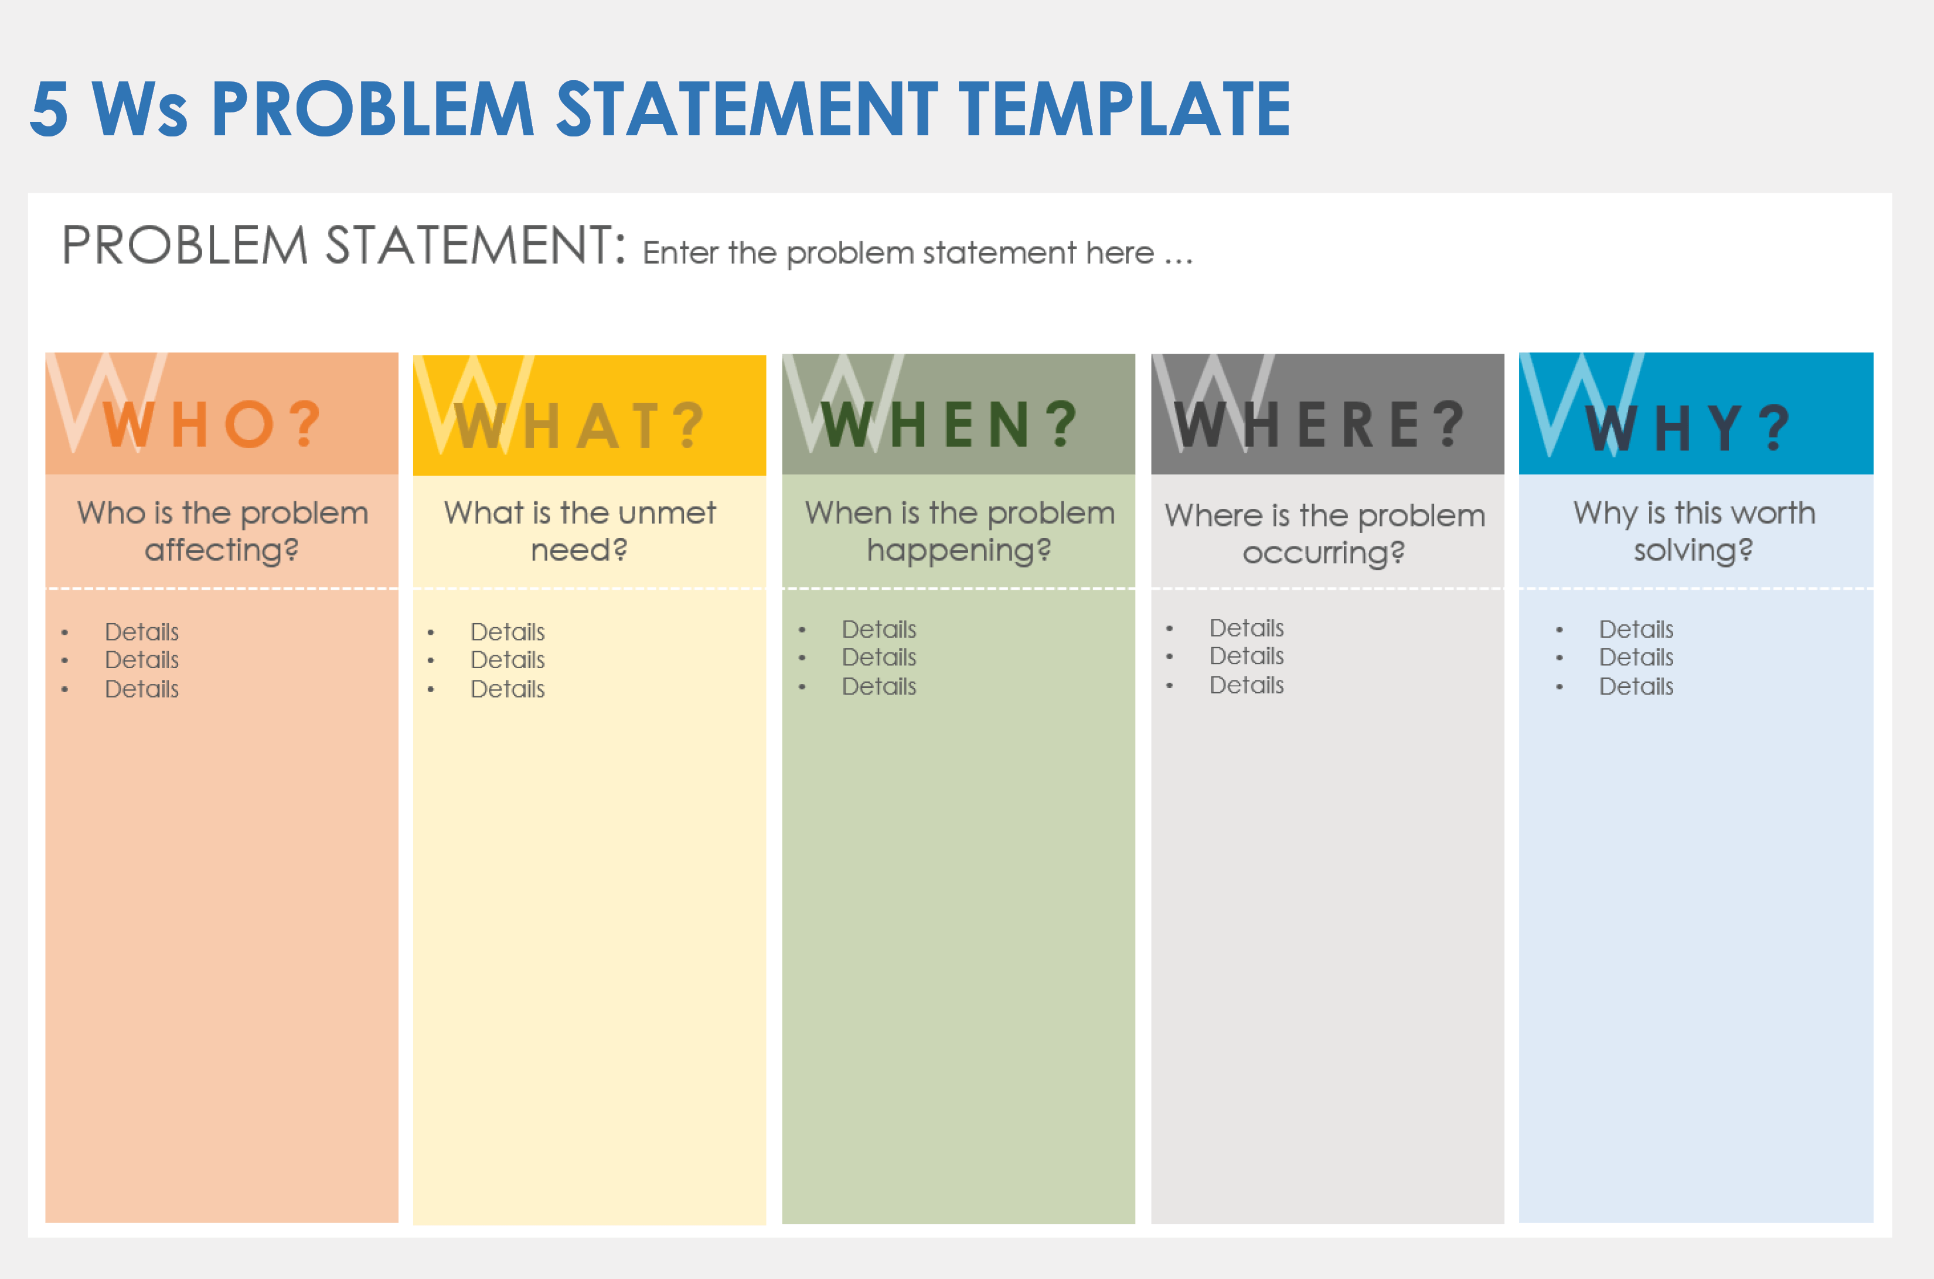

PROBLEM STATEMENT
"Analyze employee data (demographics, job titles, departments, tenure, salary, performance ratings) to identify trends, patterns, and insights. Use Excel to:- Clean and visualize data- Analyze tenure vs. salary- Identify top performers- Predict employee turnover Help me design and implement an Excel solution!"Let me know if you'd like me to expand on this or help with the analysis!

Slide 5
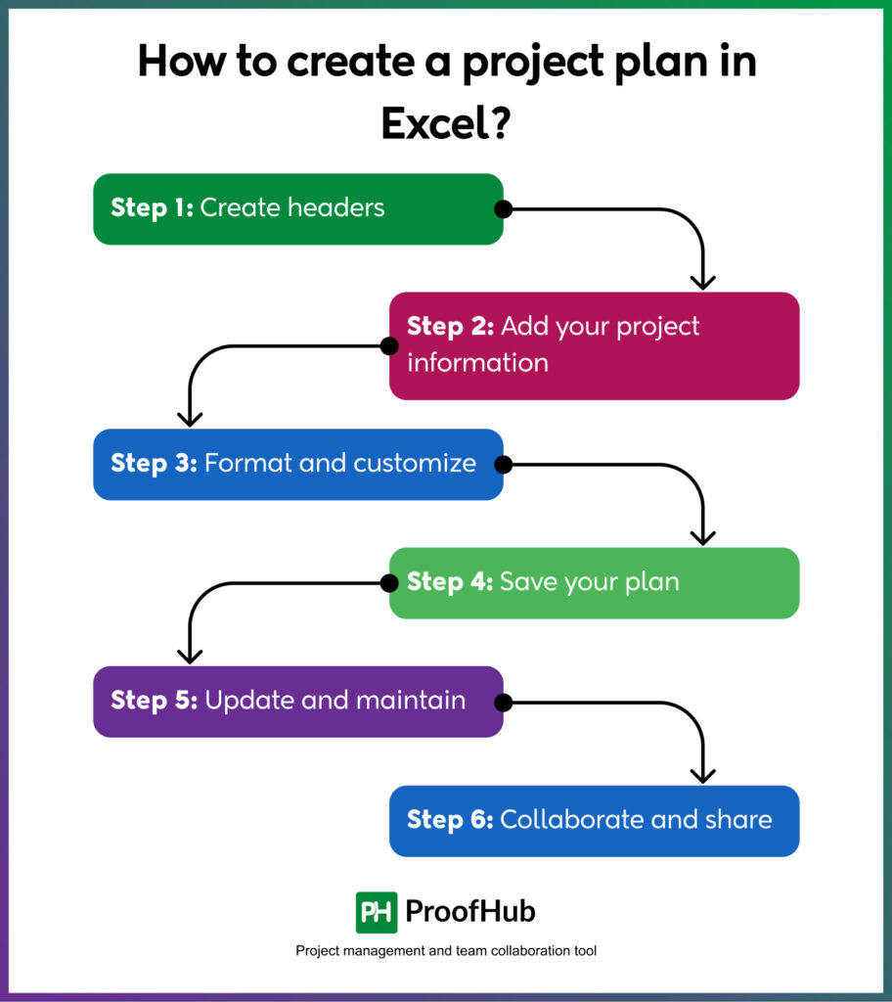

PROJECT OVERVIEW
This project overview provides a clear structure and guidelines for the employee data analysis project, ensuring a focused and effective approach.

Slide 6

WHO ARE THE END USERS?
It's usually the person's line manager, as they know most about the employee's role and their current work. In some cases, a leadership group, team leader, or a more senior leader may lead the review or someone from human resources.

Slide 7

OUR SOLUTION AND ITS VALUE PROPOSITION
Unlock actionable employee insights with our intuitive Excel dashboard, empowering HR professionals to:- Track key metrics- Identify trends- Make data-driven decisions- Enhance organizational performance
Key Benefits:- Improved decision-making- Enhanced employee engagement- Increased efficiency- Better compliance- Scalable solution

Slide 8
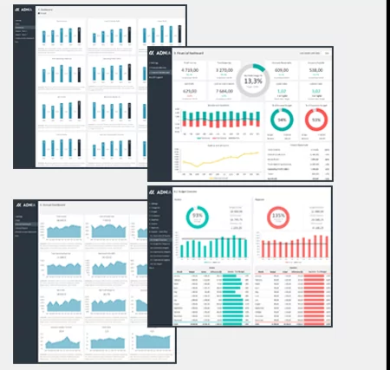
Dataset Description
The dataset contains 1000 rows (employees) and 7 columns (variables):1. Employee ID (unique identifier): a unique numerical ID for each employee2. Department (categorical): the department the employee belongs to (e.g., Sales, Marketing, IT, etc.)3. Job Title (categorical): the employee's job title (e.g., Software Engineer, Marketing Manager, etc.)4. Tenure (numerical): the number of years the employee has been with the company5. Salary (numerical): the employee's annual salary6. Performance Rating (categorical): the employee's most recent performance rating (e.g., Excellent, Good, Fair, etc.)7. Age (numerical): the employee's age

Slide 9

THE "WOW" IN OUR SOLUTION
- Auto-refreshing dashboards- Predictive modeling- Interactive visualizations- Automated reporting- Smart alerts- Data storytelling- One-click analysis These features will take our Excel solution to the next level, providing a more dynamic, interactive, and insightful experience!
3/21/2024 Annual Review
9

Slide 10
RESULTS
Here are the results for Excel, concise and to the point:
Data Insights
Predictive Analytics
Interactive Dashboards
Automated Reporting
Improved Decision Making
Increased Efficiency
Identified Areas for Improvement
Personalized Employee Profiles
Real-time Alerts
Data-Driven Storytelling
10

Slide 11
GRAPH

Slide 12
MODELLING
Excel modeling refers to creating mathematical representations of business or financial situations using Excel spreadsheets.
This involves:
1Financial modeling: forecasting revenues, expenses, and profits.
2Data modeling: organizing and structuring data for analysis.
3Predictive modeling: using statistical techniques and formulas.
4 Dashboard creation: visualizing key performance indicators(KPIs).
Some key Excel modeling skills include:
1. Excel formulas (e.g., IF, VLOOKUP, INDEX/MATCH)
2. Functions (e.g., SUMIFS, AVERAGEIFS)
3. Data visualization (e.g., charts, tables)
4. Pivot tables
5. Sensitivity analysis Would you like
Excel modeling tutorials?
Template examples?
Specific formula or function help?
Modeling best practices ?Let me know!
12

Slide 13
conclusion
Excel helps you:- Unlock insights- Make data-driven decisions- Improve employee management- Enhance performance & retention- Streamline analysis & reporting By using Excel, you can optimize your workforce and drive business success!

Slide 14
THANK YOU

